Slide 1
Proteins
Jason R Mayberry, PhD
Molecular Building Blocks of Life
Water
Proteins
Nucleic Acids
Lipids
Carbohydrates
Organic Molecules

Slide 2


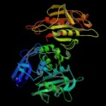
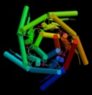
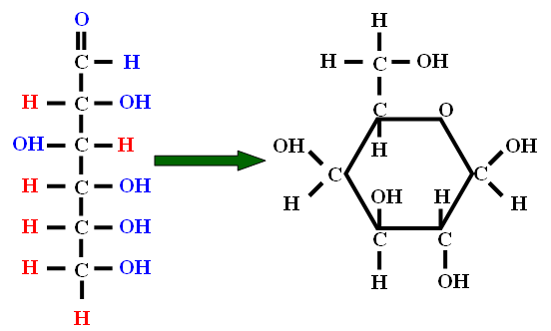
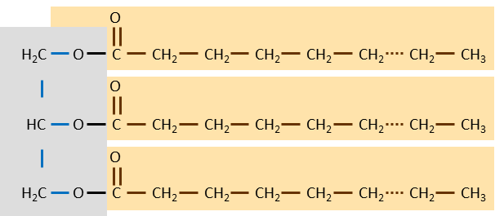
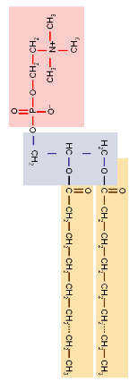
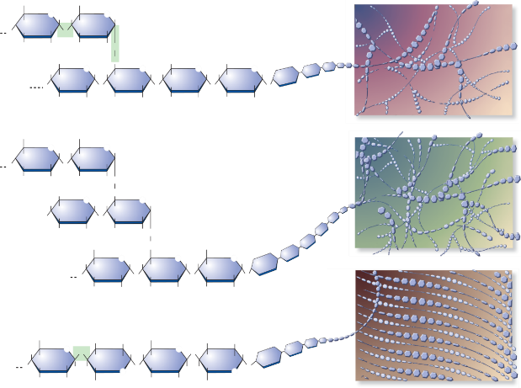
The 4 Classes of Organic Molecules
Proteins
Nucleic Acids
Enzymes
Structural Molecules
DNA Regulation
Hormones
Adhesion
Cell Recognition
Etc.
DNA
RNA
P
ATP
Carbohydrates
Lipids
Glucose
Fats
Phospholipids
Steroids
OH
Glycogen
Starch
Cellulose
O
OH
OH
Notes:
NA also
Capable of direct replication
Transmission is responsible for heredity nature of traits
Variation is responsible for variation between individuals and species

Slide 3
Proteins
Primary Roles of Proteins in Cell Structure and Function
Enzymes (many, many types; the work horses of the cell)
Cytoskeleton
DNA packaging, decoding, and regulation
Extracellular matrix
Transport proteins
Signaling molecules and Receptors
Cell Recognition
Cell-cell adhesion (like Velcro)

Slide 4
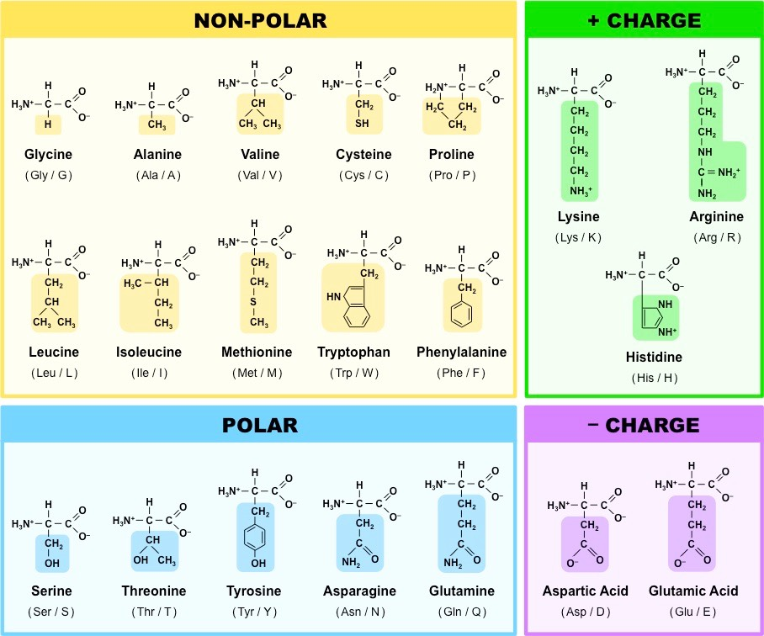
Amino Acids
Amino Acid (aa): Monomer of Proteins
“N – C – C” Backbone with Hydrogens and some Oxygens
“R” = functional groups
  20 kinds used in proteins of living things
  Different properties (see chart)
New Amino acids can be joined ad-infinitum through condensation joining Amino-end of one aa to the Carboxy end of an existing polypeptide.
Polypeptide: chains of amino acids joined together
Peptide Bond
Amino End
(N-terminus)
H
H
O
Carboxyl end
(C-terminus)
H
H
O
H
H
O
H
H
O
H
N
C
C
OH
N
H
N
C
C
OH
OH
H
C
C
N
C
C
R
R
R
R

Slide 5
Drawing Amino Acids
Generic Amino Acid
H
H
:
:
O
:
:
H
N
C
C
OH
:
R
Hydrophobic
Hydrophilic
H
H
:
:
:
:
O
H
H
O
:
:
:
:
H
N
C
C
OH
H
N
C
C
OH
:
:
CH₃
CH₂
:
OH
:
Hydrophobic and Hydrophilic Amino Acids
H
H
:
:
:
:
O
H
H
O
:
:
H
N
C
C
N
C
C
OH
:
:
CH₃
CH₂
:
OH
:

Slide 6
Hydrophilicity vs Hydrophobicity
Hydrophilic Molecules
  “Water Loving"
  Will Dissolve in water
  Have charges (full or partial)
    Ions (e.g. NaCl, HCl)
    Functional groups with lots of number of O-H, N-H and S-H bonds relative to size of molecule
  When Ionic Substances (e.g. Na+Cl-) dissolve the ions separate
  When Polar-Covalent molecules dissolve, the molecules stay intact, but one molecule separates from the other.
Hydrophobic (Lipophilic) Molecules
  “Water Fearing”
  Will not dissolve in water
  Do not have charges.
  Usually made mostly of
  C-C and C-H bonds
Because water can dissolve so many substances it is often considered the “universal solvent” and is the medium for all biochemical reactions.
Hydrophilic Molecules
δ –
δ –
δ –
δ –
δ –
Na⁺
δ –
Cl–
δ+
δ+
δ+
δ+
δ+
δ+
δ+
δ+
δ+
δ+
δ+
δ –
δ+
Table Salt
δ –
CH₂OH
δ+
δ+
δ+
O
δ –
δ+
δ –
δ –
H
H
H
OHCH₂
OH
δ –
O
Na⁺
OH
H
Cl–
HO
H
O
HO
CH₂OH
δ+
δ+
δ+
δ+
δ+
δ+
δ+
H
δ+
OH
OH
δ –
H
δ –
δ –
Sucrose: Table Sugar
δ –
δ+
δ+
δ+
δ –
δ+
δ –
δ –
δ+
δ –
δ+
δ+
δ+
also Most Proteins
δ+
δ+
δ+
δ+
δ+
δ+
δ+
also Nucleic Acids (DNA, RNA)
δ+
Hydrophobic Molecules
δ –
δ –
O
H₂C
O
δ –
C
CH₂
CH₂
CH₂
CH₂
CH₃
δ+
δ+
δ+
δ+
O
δ –
HC
O
δ+
δ+
C
CH₂
CH₂
CH₂
CH₂
CH₃
O
δ+
δ+
δ –
H₂C
O
C
CH₂
CH₂
CH₂
CH₂
CH₃
δ –
Lipids (Fats, Oils, Waxes)
δ+
δ+
δ+
δ+
δ –
δ –
δ+
δ+
δ –
OH
Steroids (derived from cholesterol)
δ+
δ+
δ+
δ+

Slide 7

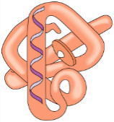
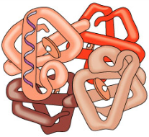
Proteins
Amino Acids in the chain interact with each other and with their environment
  Hydrophilic groups interact with each other and with the water in cytosol
  Hydrophobic groups bunch together in the middle of the protein
Interaction of Amino Acids cause the chain to fold into a precise shape
The Shape of a protein determines its function
Denature
  To cause a protein to unfold or fold wrongly
    Acid/Basic Solutions
    High Temperature
    Cooking egg-whites, meat, etc.
H
H
O
H
H
O
H
H
O
. . .
N
C
C
N
C
C
N
C
C
. . .
R
R
R
Hydrophilic Amino Acids
Hydrophobic Amino Acids
Chain of thousands of amino acids
4x
Different Proteins have different shapes; the shape determines the function of the protein.
Hemoglobin is made of 4 protein units

Slide 8

Shape Determines Function

Slide 9

Protein Folding and Function
H
H
O
H
H
O
H
H
O
Sequence of Amino Acids
. . .
N
C
C
N
C
C
N
C
C
. . .
R
R
R
Hydrophilic Amino Acids
Hydrophobic Amino Acids
Folding
Chain of thousands of amino acids
Shape
Function
Different Proteins have different shapes; the shape determines the function of the protein.

Slide 10
Protein Folding
Polypeptides Fold Into Specific Shapes
Amino Acids interact with
  Molecules in Surrounding
  Each-other
Every type of bonding is involved in a protein folding and stabilizing its shape.
H
H
O
H
H
O
N
C
C
N
C
C
CH₂
CH₂
CH₂
O
C
H
HO
O
H
H
O
Hydrogen Bond
H
N
C
C
H
CH₂
H
C
C
O
C
H₂N
O
N
CH₂
H
H
O
CH₂
Hydrophilic Amino Acids Exposed to Water
CH₂
Ionic Bond
N
C
C
H
H
O
CH₂
Hydrophobic Interactions
H₃C
CH₂
N
C
C
⁺¹H₃N
O
H
H
CH₂
O⁻¹
O
CH₂
C
N
C
CH₃
CH₂
C
CH₂
N
H
H
O
H₃C
CH₂
H₃C
CH₃
H
H
O
C
C
O
N
C
C
OH
CH₂
N
C
C
H
H
CH₂
CH₃
CH₂
CH₂
S
Covalent Bond
C
H
H
O
H₂N
O
N
C
C
CH₂
S

Slide 11
Levels of Protein structure
Primary
Secondary
Tertiary
Quaternary
Amino acid sequence
Recognizable patterns such as α-helices and β-sheets.
*Random Coil is at this same level but is not a secondary structure.
Fully folded polypeptide
When two or more proteins come together to function as one
Met
Tyr
Transcription
Ala
O
*Random Coil
Translation
N
C
C
Asp
H
Leu
N
C
O
H
C
Shape = Function
DNA
Phenotype
mRNA
Tyr
Gly
α-helix
Gln
Met
O
Thr
N
C
C
H
Glu
O
Glu
N
C
C
H
Lys
β-sheet
Lys
Representative Hydrogen Bond
Note: Side chains are removed for clarity

Slide 12
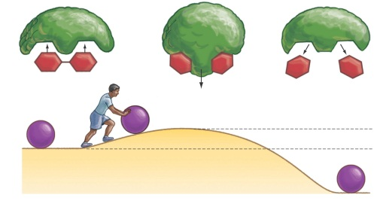
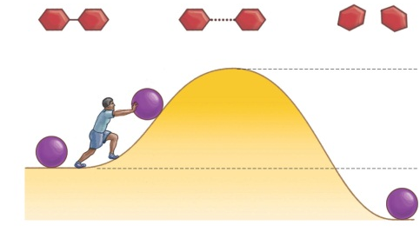


For Enzymes SHAPE and PHSICAL INTERACTION is everything.
Active Site: part of an enzyme with a shape suitable for binding to reactants (substrates)
Binding of substrates…
  Alters the way amino acids interact
  Changes the shape of the protein
  Puts substrates into intermediate state
  Energy of Activation is lowered
  Reaction occurs more quickly
Endergonic Reactions
  Require a more significant change to the enzyme shape to get to the intermediate state
  ATP modifies the protein to force the shape change. (the energy of ATP is used to make the modification)
Vitamins are coenzymes that stabilize the shape of the active sites resulting in improved function.
Negative Feedback: Self regulation of enzymes when turned off by the product binding to regulatory site.
Medicines/Drugs function by altering proteins that they are able to bind to because of their shape (can inactivate, activate, or modify function)
Regulatory Site
ATP
Active Site
Coenzyme
ADP
P_{i}
Enzyme
Without an enzyme the Activation energy is very high
Enzymes lower the Activation energy by reducing the energy of the intermediate state, thus speeding up the reaction.

Slide 13
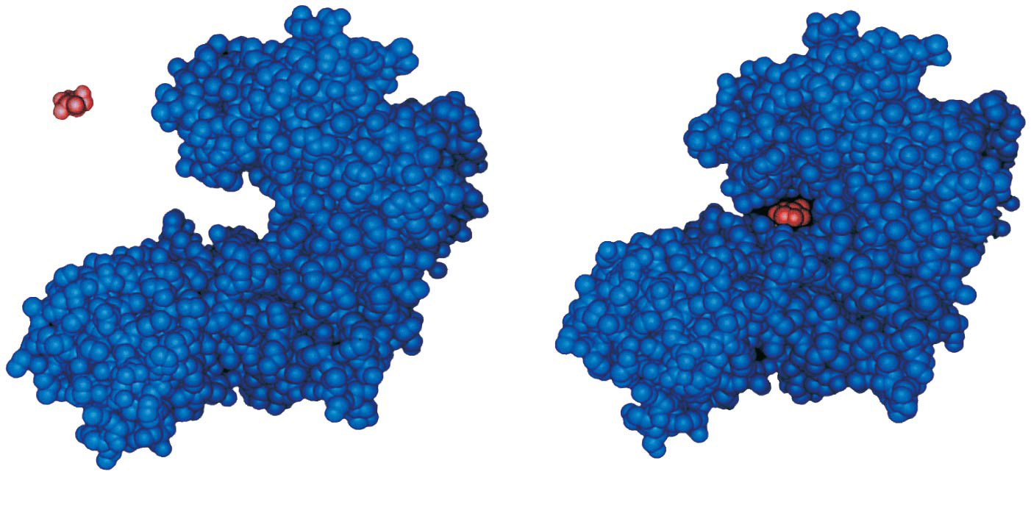
Space Filling Model of an Enzyme
Substrate
Active site
Enzyme
Enzyme-substrate
complex
Notes:
Figure 8.15 Induced fit between an enzyme and its substrate

Slide 14
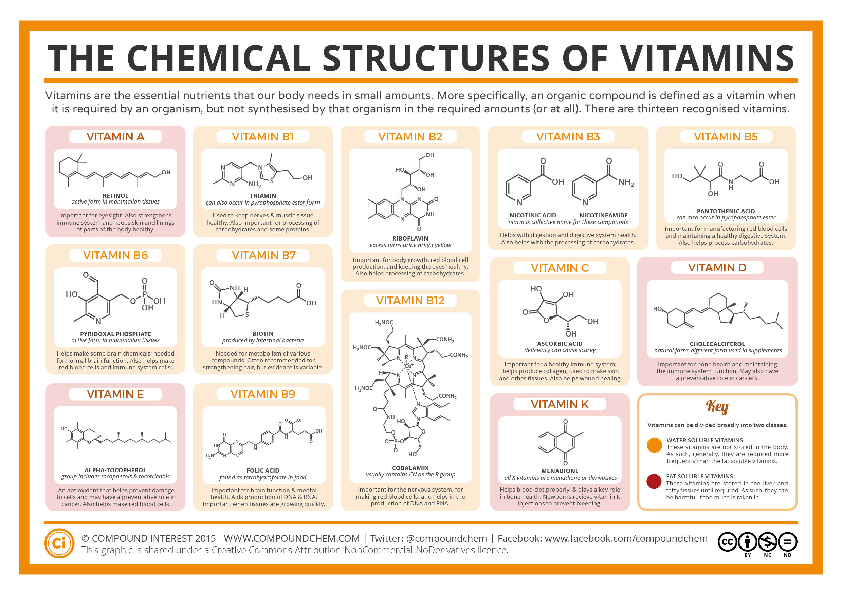
FYI: Vitamin Coenzymes.

Slide 15
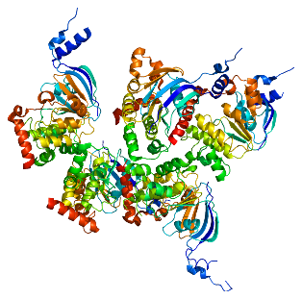
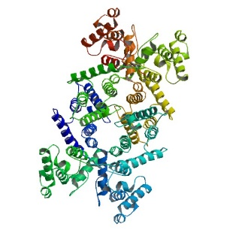
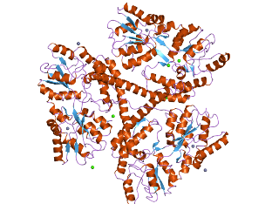
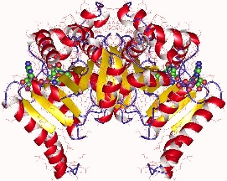
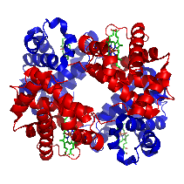
Example of Proteins and their Functions
PROTEINS
Huntingtin
CFTR
3-hydroxyacyl-CoA dehydrogenase
Hemoglobyn
Dystrophin
FUNCTION
Neuron Function
Chloride Channel
Fat Metabolism
Oxygen Transport
Skeletal Muscle Function
DISEASE DUE TO NON FUNCTIONAL FORMS OF THE GENE
Huntington’s Disease
Cystic Fibrosis
LCHAD
Sickle Cell Anemia
Muscular Dystrophy

